Slide 1

Monocular 3D pose estimation and shape reconstruction
Practical - Suren Sritharan
Notes:
I’m doing my final presentation for my practical on the topic

Slide 2
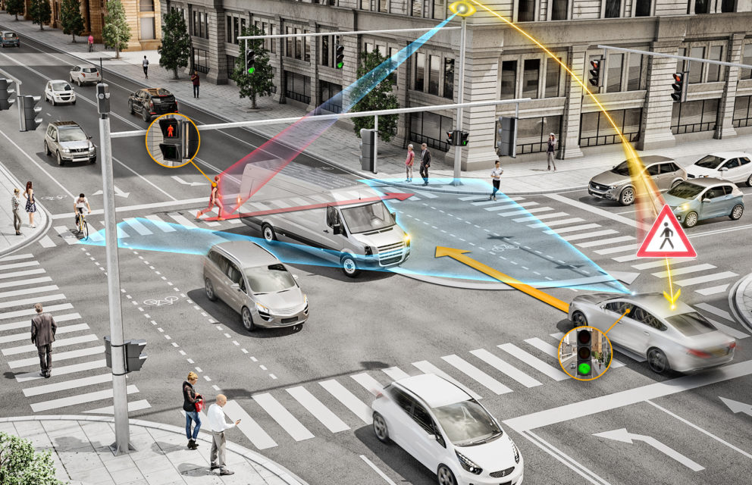
Motivation - 3D object detection
3D object detection is vital for autonomous driving tasks.
Traditionally, “object detection” refers to the estimation of the position and orientation of bounding boxes.
Estimating 3D bounding boxes ignores details in regards to the exact shape and type of object.
Notes:
Motivation… (30)
Object detection in the context of autonomous driving is vital.
Identifying vehicles and vulnerable road users helps us in a wide range of applications.
Majority of the 3D object detection models focus on creating a bounding box around the object and thereby estimating its position, orientation, class, size, etc...
However, this results in generalization of the object shape across the entire class.
This leads to loss in minute details.

Slide 3
Monocular 3D pose estimation and shape reconstruction
Reconstruct 3D shape and pose of vehicular objects from monocular images
Notes:
Motivation… (30).. 1m
Thus, the objective of this project is to reconstruct the exact 3D shape of the object, and estimate the pose of the object at the same time.
This has a wide range of applications in applications like digital twin, etc.

Slide 4
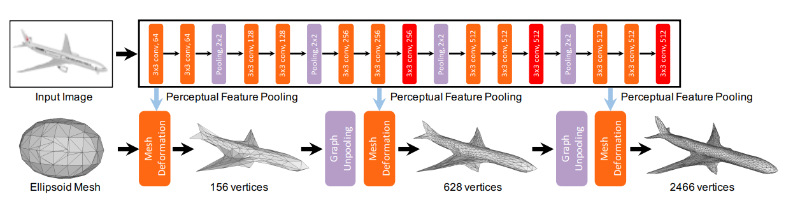
Definition - shape reconstruction and pose estimation
Shape reconstruction
Estimating the 3D shape of the object from a given image.
Representation of the object can vary.
“Pixel2Mesh: Generating 3D Mesh Models from Single RGB Images”, ECCV 2018
Notes:
First looking at the problem definition, the entire problem has two components.
The first part is to estimate the shape from a given image.
The example here is from the paper pixel2mesh, where shapes of individual objects are reconstructed from a deformable sphere.
In this example, a mesh representation is used for reconstruction… However, other representations like voxels can also be used

Slide 5
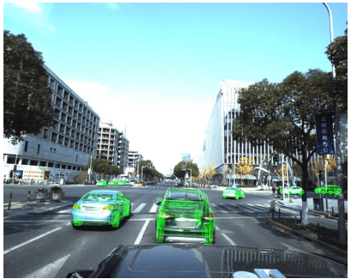
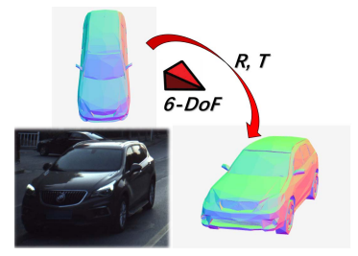
Definition - shape reconstruction and pose estimation
Shape reconstruction
Estimating the 3D shape of the object from a given image.
Representation of the object can vary.
Pose estimation
Estimating the 3D pose of an object : position and rotation
Based on bounding boxes or 3D shapes
“6D-VNet: End-to-end 6DoF Vehicle Pose Estimation from Monocular RGB Images”, CVPRW 2019
Notes:
The second part is to estimate the pose of an object from a given image.
The pose usually refers to the 6DOF, which we usually refer to as the rotation and translation component.
In this example, a the 6DOF are estimated from a given image and a fixed shaped object

Slide 6
Definition - shape reconstruction and pose estimation
Shape reconstruction
Estimating the 3D shape of the object from a given image.
Representation of the object can vary.
Pose estimation
Estimating the 3D pose of an object : position and rotation.
Based on bounding boxes or 3D shapes.
Shape reconstruction + Pose estimation
Simultaneously perform both tasks.
Prior works are not in abundance.
Notes:
2 min
Now these 2 components can be combined together to jointly estimate both the shape of the object and the pose. This will be the focus of this project

Slide 7
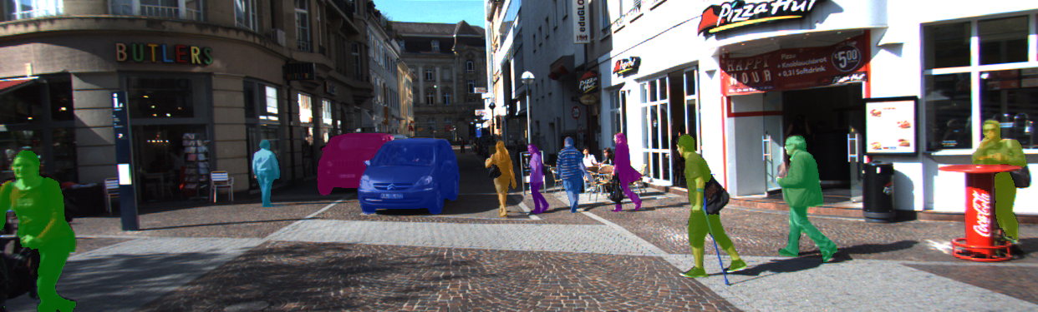
Dataset - Vehicular object detection
KITTI, Nuscenes, …
Contains 3D bounding box annotations, semantic segmentation, etc.
Does NOT contain 3D shape information.
“MOTS: Multi-Object Tracking and Segmentation”, CVPR 2019
Notes:
Next when looking at the datasets available…
The first set of dataset are generic vehicular object detection datasets such as Nuscenes, KITTI, Waymo… etc.
These are used for variety of application, and they contain labels such as bbox annotations and segmentation masks…
However, they do not contain the exact 3D shape information.
The figure shows the KITTI MOT dataset which contain segmentation label

Slide 8
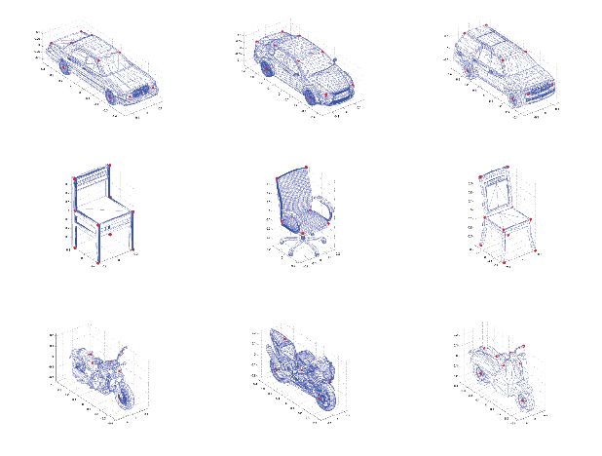
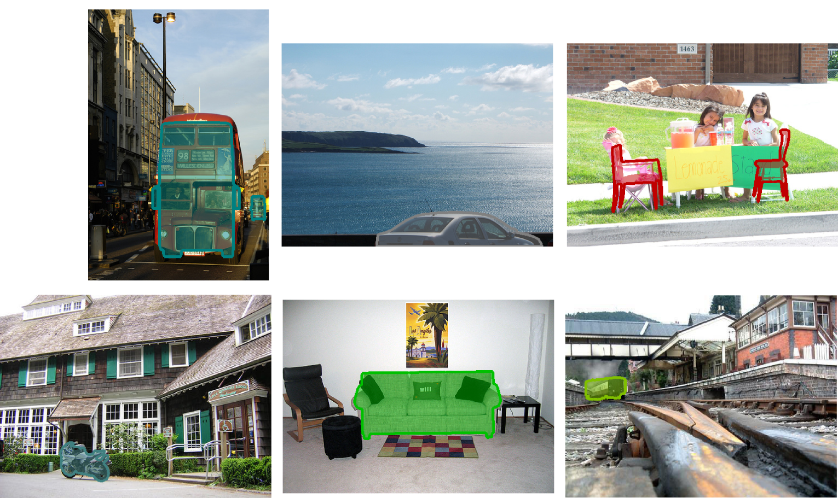
Dataset - Vehicular object detection
KITTI, Nuscenes, …
Contains 3D bounding box annotations, semantic segmentation, etc.
Does NOT contain 3D shape information.
Pascal3D+ dataset
CAD models of 12 rigid categories. Classes include cars, bikes, etc.
Can be used for object detection (mAP) and pose estimation (AVP)
“Beyond PASCAL: A benchmark for 3D object detection in the wild”, WACV 2014
Notes:
The next dataset is the pascal3D+ dataset, which is an extension of the pascal dataset.
In addition to the pose labels, the dataset contains the 3D shape given as CAD model…
It can be used for object detection and join pose estimation (Average Viewpoint Precision)

Slide 9
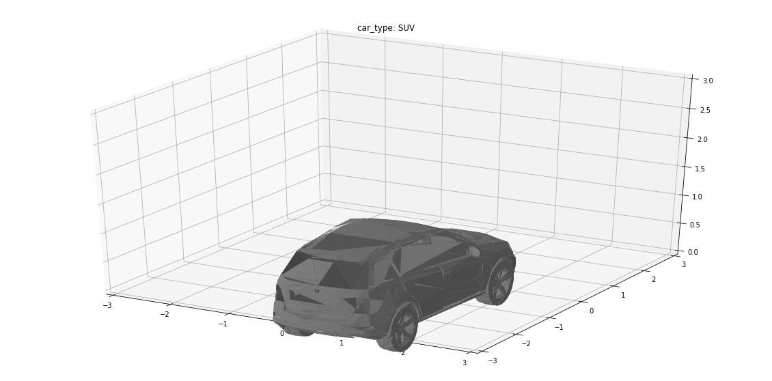
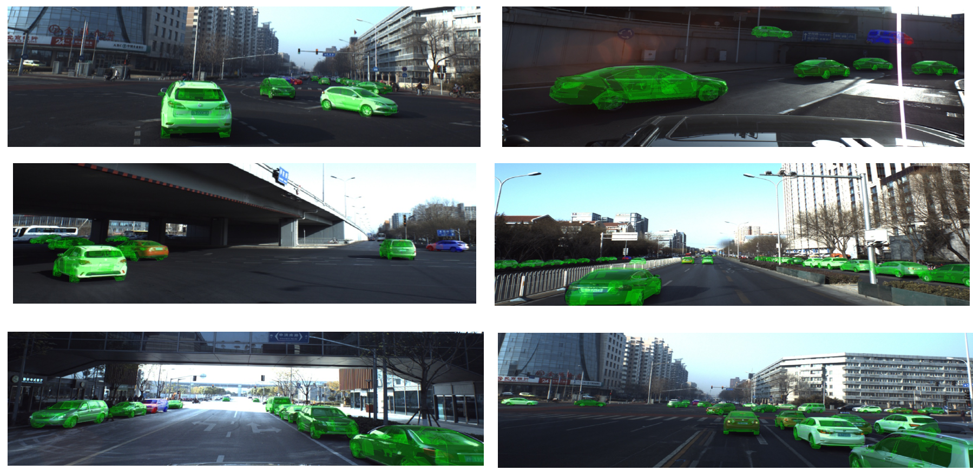
Dataset - Vehicular object detection
KITTI, Nuscenes, …
Contains 3D bounding box annotations, semantic segmentation, etc.
Does NOT contain 3D shape information.
Pascal3D+ dataset
CAD models of 12 rigid categories. Classes include cars, bikes, etc.
Can be used for object detection (mAP) and pose estimation (AVP)
ApolloCar3D
Includes 3D models (mesh) of 79 car types, and labeled monocular images.
“ApolloCar3D: A Large 3D Car Instance Understanding Benchmark for Autonomous Driving”, CVPR 2018
Notes:
Dataset (20).. 3m
The final dataset is the apolloCar3D dataset, which is the dataset used in this study.
It contains around 4K train and 1K test images with annotations totaling around 30K annotations.
These annotation includes the both the 3D pose as well the the shape which is represented as mesh containing 1352 vertices.
Since this contains both the pose and the shape, this dataset was chosen.

Slide 10
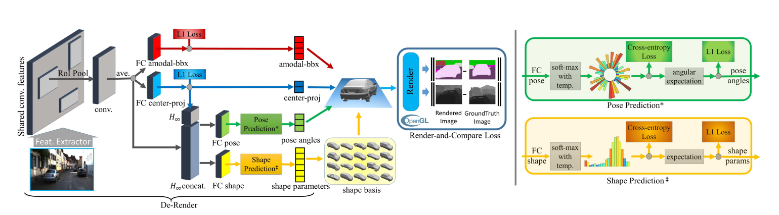
Prior works
3D-RCNN: Instance-level 3D Object Reconstruction via Render-and-Compare (2018)
Notes:
(30)
Next to identify a baseline model, prior works were considered. There are not many works on this topic…
However, I’ll briefly show three related works.
The first is 3D RCNN,, which uses a RCNN based backbone for 3D shape and pose estimation.
The RCNN backbone provides finds the size and position of 2D bbox.
In addition a shape predictor and pose predictor predictor predicts these two separately.
This is one of the works which is not based on Apollo3D dataset, but instead uses Pascal3D and KITTI dataset

Slide 11
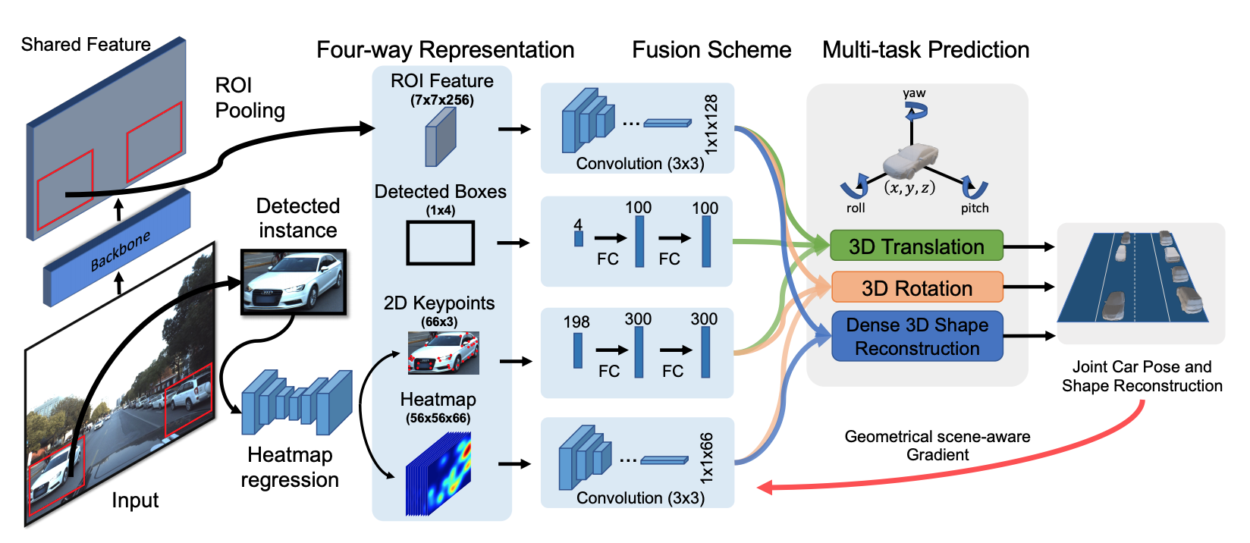
Prior works
3D-RCNN: Instance-level 3D Object Reconstruction via Render-and-Compare (2018)
GSNet : Joint Vehicle Pose and Shape Reconstruction with Geometrical and Scene-aware Supervision (2020)
Notes:
Prior (30)
The next work is GSNet which uses a similar architecture.
The backbone is based on mask RCNN which extracts the ROI, the feature, and 66 keypoints which are specific to Apollo3D dataset.
Based on these extracted information 3 different CNN based components are used to predict the R, T, and shape

Slide 12
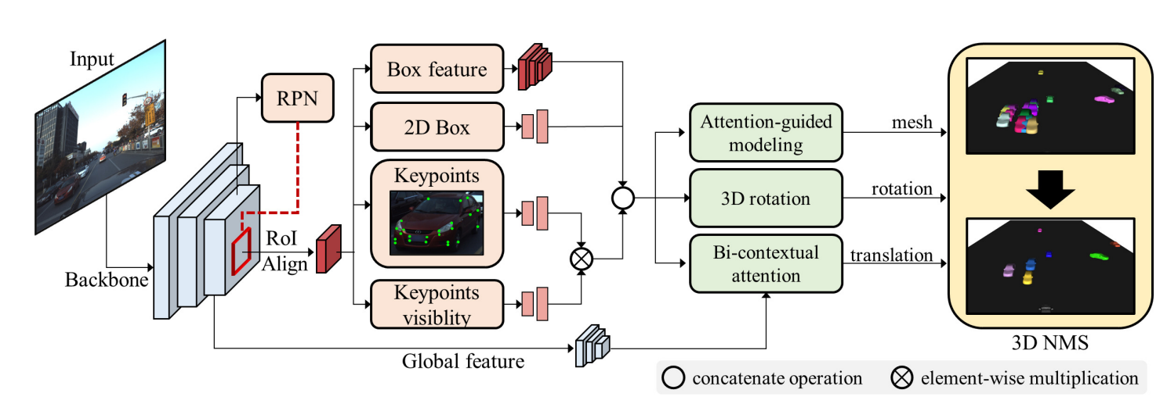
Prior works
3D-RCNN: Instance-level 3D Object Reconstruction via Render-and-Compare (2018)
GSNet : Joint Vehicle Pose and Shape Reconstruction with Geometrical and Scene-aware Supervision (2020)
BAAM: Monocular 3D pose and shape reconstruction with bi-contextual attention module and attention-guided modeling (2023)
Notes:
Prior (30).. 4.5m
The final work, BAAM is the most recent and SOTA in this field.
This again has a very similar architecture where the backbone extracts the same information.
However, the R, T, and shape are estimated based on attention mechanisms instead of general CNNs.

Slide 13
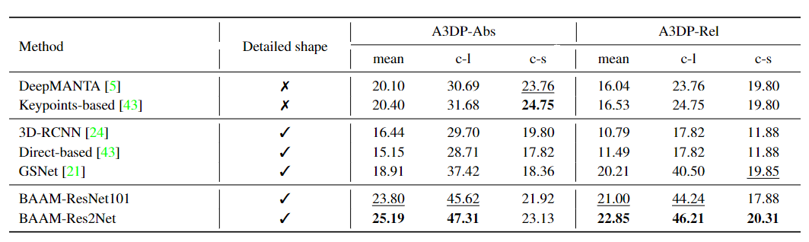
Prior works - Performance comparison
Quantitative comparison on ApolloCar3D based on Average 3D precision (A3DP) metric.
“BAAM: Monocular 3D pose and shape reconstruction with bi-contextual attention module and attention-guided modeling”, CVPR 2023
Notes:
(60)
To find a baseline the models were compared with A3DP as the metric.
I will explain later, but this is similar to AP and varies between 0 and 100.
As seen, BAAM outperforms all other methods, in every metric expect a few…
Because of this BAAM was used as a baseline, and we planned on developing a model with this as the skeleton.
However, there are still certain shortcomings of BAAM in terms of robustness and its ability to be extended to other datasets.

Slide 14
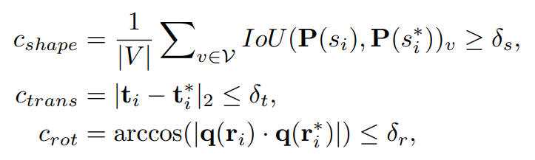
Quantitative metrics
Average 3D precision (A3DP) introduced in ApolloCar3D dataset.
A3DP
mean : Mean of all 3D precision values
c-l : loose criterion = [0.5, 2.8, π/6]
c-s : strict criterion = [0.75, 1.4, π/12]
{𝛿_{s}} = [0.5 : 0.05 : 0.95]
{𝛿_{t}} = [2.8 : 0.3 : 0.1]
{𝛿_{r}} = [π/6 : π/60 : π/60],
Notes:
Explain metric (30) … 6.30
So to give a short explanation about A3DP..
In general 3D object detection the models, the precision is calculated by considering the 3D IOU between the ground truth and the predicted boxes. And if this IOU is above a threshold then the prediction is considered to be correct.
However, when it comes to 3D shapes, the exact IOU cannot be calculated. Thus, we define that a prediction is correct only if the IOU of the projection is within above a threshold, but at the same time the translation and rotation errors must be below a threshold.
Furthermore, the mean AP is measured as the mean of all the precision for different thresholds. However, in addition to this a loose criterion and a strict criterion is defined.

Slide 15
Towards unsupervised 3D reconstruction
Shortcomings
Dependance on keypoint labels
Dependance on template shapes
3D shape labels required for supervised training
Template
Supervision
Keypoint
Notes:
(60)
Next coming back to the baseline model, it does have certain shortcomings.
The first is the dependency on annotations which are specific to the apolloscape dataset.
Specifically the backbene uses keypoints, and the AGM module uses templates which are dataset specific. and cannot be extended to general apps.
The final issue is that the model requires supervised training… and in general datasets with shape annotation are not in common. Thus moving onto an unsupervised method is important.

Slide 16
Towards unsupervised 3D reconstruction
Objectives
Remove dependency on keypoint labels and template shapes.
Update model to achieve similar performance without additional features.
Move towards semi-supervised / unsupervised learning techniques for training.
Notes:
(30)
Thus the objective of this practical was to make the model work on generic dataset
First by removing dependency on keypoints and templates.
Next, the training method should be modified such that it’s semi / self sup or unsupervised..
And this would require updating the model architecture as well, especially due to the loss of information.

Slide 17
Towards unsupervised 3D reconstruction
Objectives
Remove dependency on keypoint labels and template shapes.
Update model to achieve similar performance without additional features.
Move towards semi-supervised / unsupervised learning techniques for training.
Roadmap
Supervised - generic data
Supervised - Transformer
Semi-supervised - segmentation labels
Unsupervised
- Remove keypoints
- Remove template information
- Update model architecture
- Transformer detection head
- Segmentation labels for training
- Training based on “render and compare loss”
completed
WIP
Todo
Notes:
(30)... 8.30
These objectives were divided into a roadmap, where the first objective was to remove the keypoint and templates.
Next the architecture was to be updated such that it can cope with the loss of information.
The next objective was to move onto a semi-supervised training technique where the training would be based on segmentation and not 3D shapes.
And the final step would be to move to an unsupervised technique. The first part of the roadmap was completed, however, the reset were still WIP and incomplete.
Next we’ll go through these steps one by one.

Slide 18
Exp 1.1 : Removing keypoints
Removed key-point extractor from the 2D feature extraction backbone
Object features would only consist of the ROI box and the corresponding features
Increase the dimension of object features / global features.
Dimension
Keypoint
Notes:
(30)
First the keypoint were removed from the 2D feature extractor. Then the object features would only contain the 2D bbox and box features.
However, to cope with the loss of informtaion the dimension of the extracted features was increased.

Slide 19
Exp 1.1 : Removing keypoints - results
Method | A3DP - abs |  |  | A3DP - rel
 | mean | c-l | c-s | mean | c-l | c-s
BAAM | 23.82 | 46.60 | 21.09 | 21.16 | 43.68 | 18.52
w/o keypoints | 20.97 | 42.36 | 18.93 | 15.50 | 35.22 | 11.98
w/o keypoints + x2 | 21.19 | 41.76 | 18.43 | 16.03 | 34.83 | 12.03
Notes:
(30)... 9.5
When looking at the quantitative results… we observed that as soon as the keypoints were removed, the model experienced a drop in performance…
Around -3.0 for abs value and -6.0 for relative.
Then when the dimension of object features was increased there was a slight increase in the performance of around +0.2 but this is negligible.

Slide 20
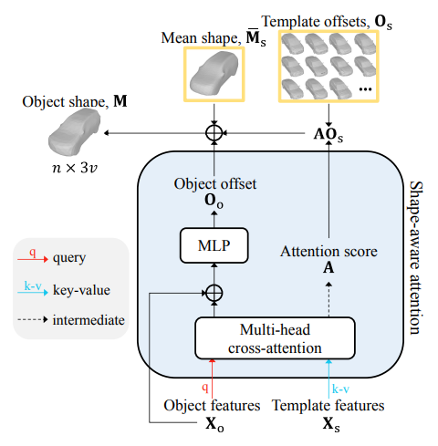
Exp 1.2 : Removing template shapes
Remove dependency on template shapes
Replace cross-attention with self-attention
Increase the dimension of object features / global features.
M = M_{s} + AO_{s} + O_{o}
M_{s} = mean(V)
O_{o} = MLP (X_{o} + C)
O_{s} = V - Ms
V : Template
C : context
A : Attention
Notes:
(30)
The next objective was to remove the template features from the AGM module.
The AGM module, is the part which predicts shapes from object features using an attention mechanism
It uses a cross attention mechanism, where the module attends to the object and template features.
Finally object shape is obtained from the mean shapes, the object offset, and the template offset.
However, to remove the dependance from templates the template features and offsets must be removed (right part)

Slide 21
Exp 1.2 : Removing template shapes
Remove dependency on template shapes
Replace cross-attention with self-attention
Increase the dimension of object features / global features.
M = M_{s} + AO_{s} + O_{o}
M_{s} = mean(V)
O_{o} = MLP (X_{o} + C)
V : Template
C : context
A : Attention
self attention
Notes:
(30)
This was done by replacing the cross attention module with a self attention module.
Now the shape is reconstructed only from the mean class and object offset.
Thus instead of having 79 classes of cars, there would only be one class.

Slide 22
Exp 1.2 : Removing template shapes - results
Method | A3DP - abs |  |  | A3DP - rel
 | mean | c-l | c-s | mean | c-l | c-s
BAAM | 23.82 | 46.60 | 21.09 | 21.16 | 43.68 | 18.52
w/o template | 21.67 | 41.44 | 20.06 | 17.20 | 36.61 | 13.63
w/o template, keypoint | 17.21 | 39.68 | 13.36 | 11.78 | 29.57 | 7.87
w/o template, keypoint + x2 | 19.27 | 41.25 | 17.20 | 12.77 | 31.34 | 9.41
Notes:
(30)... 11
When looking at the results of this modification, we observe that as soon as the template features are removed the A3DP value drops too (-2.0, -4.0)
Then when the keypoints are removed the performance drops further (-2.0, -4.0)
However, in this case when the dimension of the object features are increased, there is a slight increase in performance (2.0 non negligible)

Slide 23
Exp 1.3 : Removing mean shape
Remove dependency on mean shape
Reconstruction only based on object features.
Increase the dimension of object features / global features.
M = M_{s} + AO_{s} + O_{o}
O_{o} = MLP (X_{o} + C)
V : Template
C : context
A : Attention
self attention
Notes:
(30)
Finally we also removed the mean shape since this is derived from template offset.
This would be important for use with other classes since mean shape only includes cars.
Now the object is reconstructed only using the object features.

Slide 24
Exp 1.3 : Removing mean shape - results
Method | A3DP - abs |  |  | A3DP - rel
 | mean | c-l | c-s | mean | c-l | c-s
BAAM | 23.82 | 46.60 | 21.09 | 21.16 | 43.68 | 18.52
w/o mean shape, template | 22.12 | 44.15 | 20.32 | 20.98 | 43.66 | 18.22
w/o template, mean shape, keypoint | 18.47 | 40.95 | 14.37 | 12.76 | 31.14 | 8.35
GSNet | 18.91 | 37.42 | 18.36 | 20.21 | 40.50 | 19.85
Notes:
(30)... 12
These were the general results when dependency on annotations was removed
rel puts more importance to vehicles nearby

Slide 25
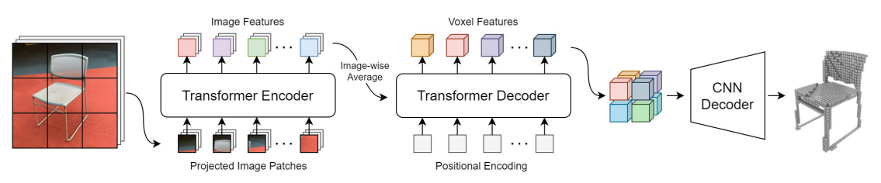
Exp 2.1 : Shape reconstruction with Transformers
Replace CNN encoder and Attention based decoder (AGM) with Transformer
Use transformer based architecture for shape reconstruction from single view image
Model chosen based on 3D-RETR
encoder-decoder backbone pre trained on ShapeNet dataset
CNN decoder (detection head) replaced with mesh reconstruction head
“3D-RETR: End-to-End Single and Multi-View 3D Reconstruction with Transformers” BMVC 2021
Notes:
Our next plan was to update the model architecture to cope with the loss of information.
Simply increasing the dimension of the object features did not help much, so it was important to update the architecture.
The idea we had was to use a transformer mechanism since they have shown to outperform many CNN based models.
Specially in the case of BAAM it has a CNN based encoder and AGM decoder, which we wanted to replace with a transformer model.
The model we chose for this purpose was based on this 3D-RETR paper. The encoder / decoder backbone is pretrained using Shapenet.
The entire model reconstructs voxels, however, since we needed mesh, the detection head (CNN decoder) should be changed.

Slide 26
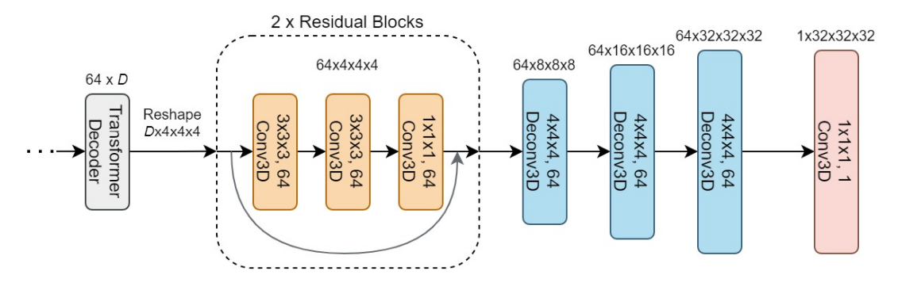
Exp 2.1 : Shape reconstruction with Transformers
encoder-decoder backbone pre trained on ShapeNet dataset.
CNN decoder (detection head) replaced with mesh reconstruction head.
Use of 2D conv, 1x1 conv
CNN decoder from “3D-RETR: End-to-End Single and Multi-View 3D Reconstruction with Transformers” BMVC 2021
Notes:
13
IF we look at the detection head… CNN decoder…
The CNN decoder uses many 3D convolution blocks, and our objective was to replace / follow this with 2D conv and linear layers to get a 3v output.
However, due to lack of time and resources this part is still WIP and incomplete..

Slide 27
Summary
Progress
BAAM is the SOTA for shape reconstruction and pose estimation.
It has certain shortcomings with dependance on labels.
Removing information leads to drop in performance.
Next steps
Train the transformer in end-to-end manner.
Incorporate mesh detection head.
Semi-supervised training using segmentation labels.
Incorporate “render-and-compare” loss to training.
Future works
Extend model towards self-supervised / unsupervised techniques.
Incorporate stereo images to estimate scale.
Notes:
15

Slide 28
Thank you

Slide 29
References
Lee, H. J., Kim, H., Choi, S. M., Jeong, S. G., & Koh, Y. J. (2023). BAAM: Monocular 3D pose and shape reconstruction with bi-contextual attention module and attention-guided modeling. In Proceedings of the IEEE/CVF Conference on Computer Vision and Pattern Recognition (pp. 9011-9020).
Ke, L., Li, S., Sun, Y., Tai, Y. W., & Tang, C. K. (2020). Gsnet: Joint vehicle pose and shape reconstruction with geometrical and scene-aware supervision. In Computer Vision–ECCV 2020: 16th European Conference, Glasgow, UK, August 23–28, 2020, Proceedings, Part XV 16 (pp. 515-532).
Kundu, A., Li, Y., & Rehg, J. M. (2018). 3d-rcnn: Instance-level 3d object reconstruction via render-and-compare. In Proceedings of the IEEE conference on computer vision and pattern recognition (pp. 3559-3568).
Shi, Z., Meng, Z., Xing, Y., Ma, Y., & Wattenhofer, R. (2021). 3D-RETR: end-to-end single and multi-view 3D reconstruction with transformers. arXiv preprint arXiv:2110.08861.
Song, X., Wang, P., Zhou, D., Zhu, R., Guan, C., Dai, Y., ... & Yang, R. (2019). Apollocar3d: A large 3d car instance understanding benchmark for autonomous driving. In Proceedings of the IEEE/CVF Conference on Computer Vision and Pattern Recognition (pp. 5452-5462).
Xiang, Y., Mottaghi, R., & Savarese, S. (2014, March). Beyond pascal: A benchmark for 3d object detection in the wild. In IEEE winter conference on applications of computer vision (pp. 75-82). IEEE.
Notes:
Varies based on type of person, time of day and location capacity

Slide 30
Appendix

Slide 31
Project timeline
Literature survey
Pose and shape estimation Datasets
Design and Implementation
Test baseline models Updating model design Implement and experiment
W3
W8
W1
W4
Data analysis
Analysis on the Apollo3D dataset and KITTI MOT dataset
Evaluation and documentation
Quantitative evaluation Create visualizations Writing report

Slide 32
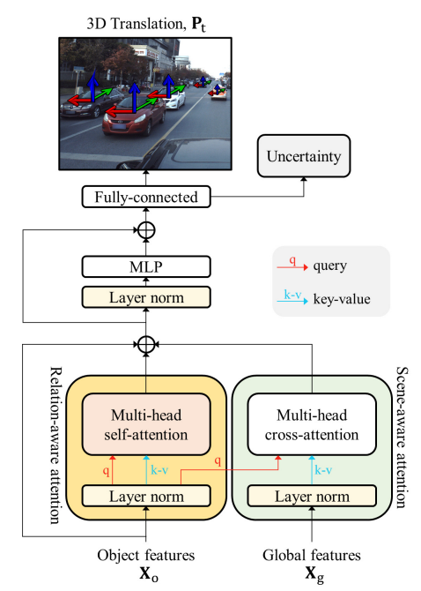
Bi Contextual Attention

Slide 33
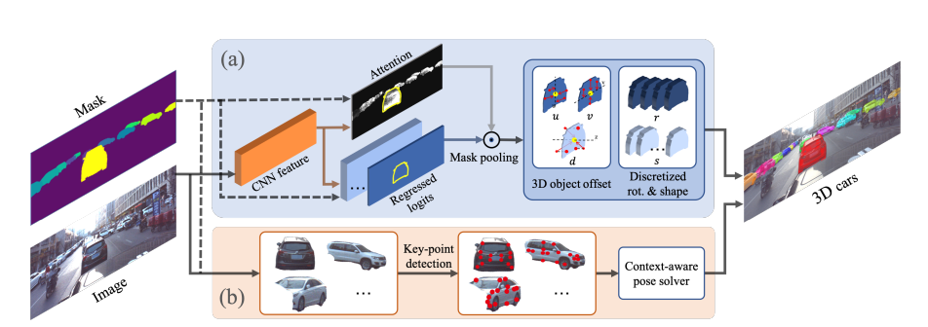
Direct Approach

Slide 34
Exp 1 : Removing keypoints - training curves
Notes:
(20)... 7.5

Slide 35
Exp 2 : Removing template shapes - training curves
Notes:
(30)... 8.5

Slide 36
Exp 3 : Removing mean shape - training curves
Notes:
(30)... 9.5

Slide 37
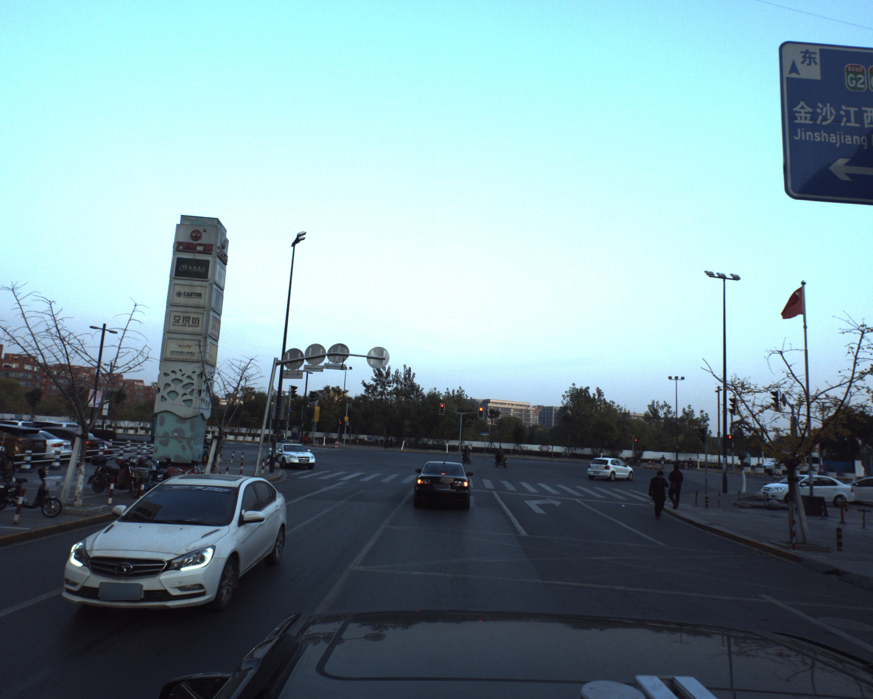
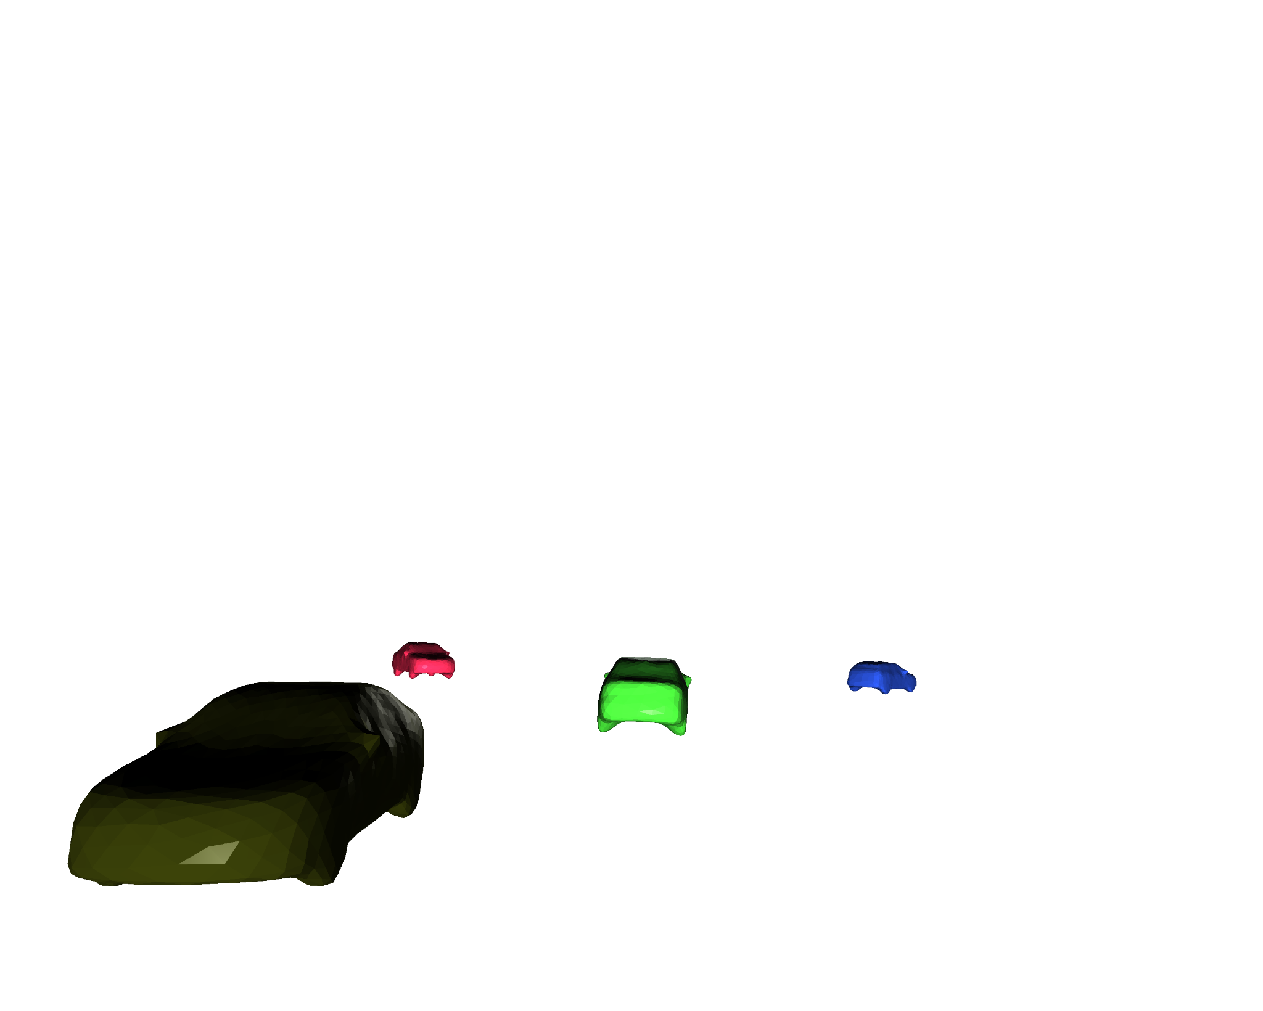
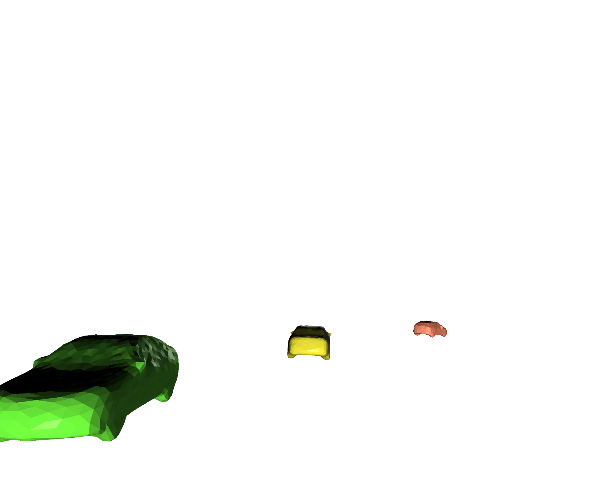
Qualitative comparison
Input image
BAAM
w/o kepoints , templates

Slide 38
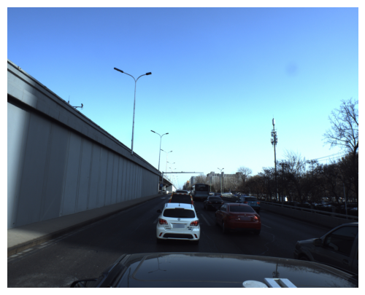

Render and Compare
Input image
Projected predictions

Slide 39
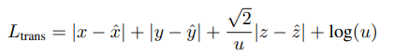
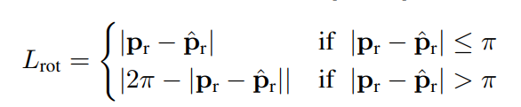
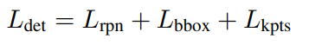
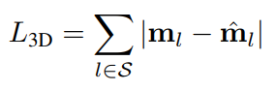
BAAM Loss
Reconstruction loss
L_{shape} : L2 loss
2D Detection loss
3D space loss

